Slide 1
Algorithm to Determine
whether a given Number is an Armstrong Number
DAA - Assignment 2

Slide 2

Armstrong Numbers
The Armstrong number is deﬁned as an n-digit number that is equal to the sum of the nth powers of its digits.
For instance,
The breakdown of the number 1634 would be as follows,

Slide 3
1.
To check whether a given number is an
Armstrong Number
sum ← 0 size ← 0 temp ← number while ( temp ≥ 0 ) do temp ← temp/10 size ← size + 1 end while while ( number ≥ 0 ) do sum ← sum + power(number%10, size) number ← number/10 end while if (number = sum) then return true else return false end if

Slide 4

2.
To calculate the value of
Input: a, b
answer ← 1 while ( b ≥ 0 ) do if ( b & 1 ) then answer ← answer*a end if a ← a ∗ a b ← b/2 end while

Slide 5
Time
Complexity
θ(nlog(n))

Slide 6
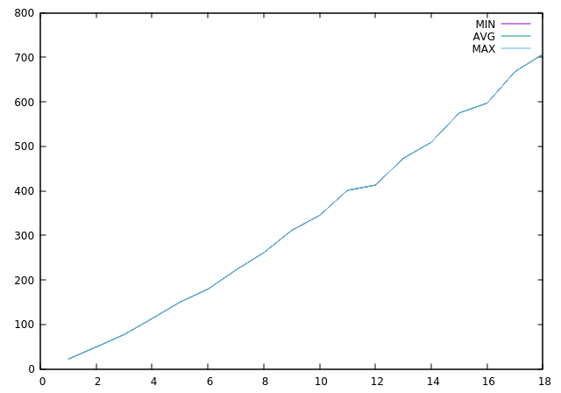

Slide 7
Thanks!
Himank Goel (IIT2016061)
Siddhant Gautam (IIT2016069)
Ankit Shrey (IIT2016050)
Akshat (IIT22016094)

